Slide 1
Retail Inventory Optimization Project
Prevent Overstocking and Understocking
-Yasmine CHattipara

Slide 2
Objective
Development of a comprehensive inventory management strategy for Bibitor, LLC*note1 .
By conducting this inventory analysis, Bibitor, LLC*note1 aims to improve its inventory management practices, reduce costs, and enhance customer satisfaction by ensuring the availability of products.
Predict optimal stock levels to prevent overstocking and understocking.

Slide 3
Data Collection
Bibitor, LLC*note1, a liquor store chain in the fictional state of Lincoln. Bibitor has asked the team to complete due diligence on their wine and spirits business looking at data for their beginning and ending inventory and sales for a 12 month period.
https://www.kaggle.com/code/bhanupratapbiswas/inventory-analysis-case-study-by-bhanu

Slide 4
Data Analysis
Import the tables Sales, Inventory Begin and Inventory end from the csv file to SQL.
Check the data in table using SELECT query.

Slide 5
Data Cleaning
Check for the NULL values
Check for Duplicates
Standardize Text Column – Trim trailing/leading spaces
Standardize Date Column
Standardize Size into a uniform unit (mL)

Slide 6
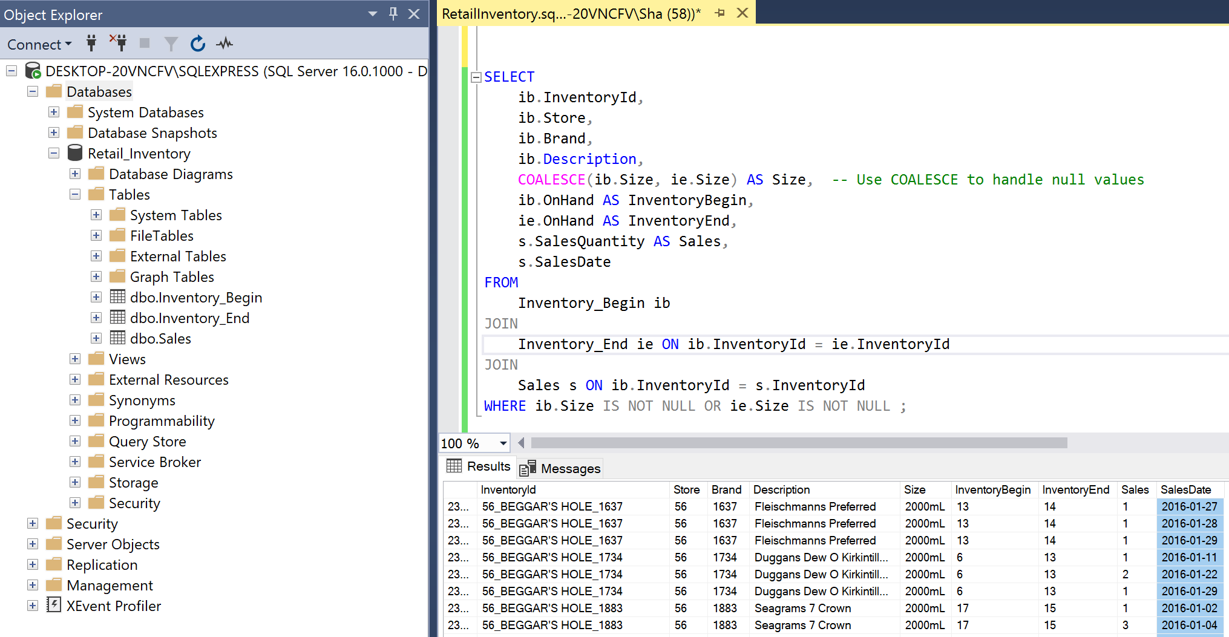
Data Model
Join the tables using the Inventory_Id

Slide 7
Analyze data and predict future inventory needs using Python
Use of Pandas and SQLAlchemy to connect to SQL Server and execute queries.
Use pd.read_sql_query() to execute the SQL query and load data into a Pandas DataFrame

Slide 8
Data Exploration -Python
Get information about the DataFrame using info()
Remove "ml" from the Size column in the original DataFrame
Check for missing values isna().sum()
Summary of the descriptive statistics for numerical columns in the DataFrame – describe()

Slide 9
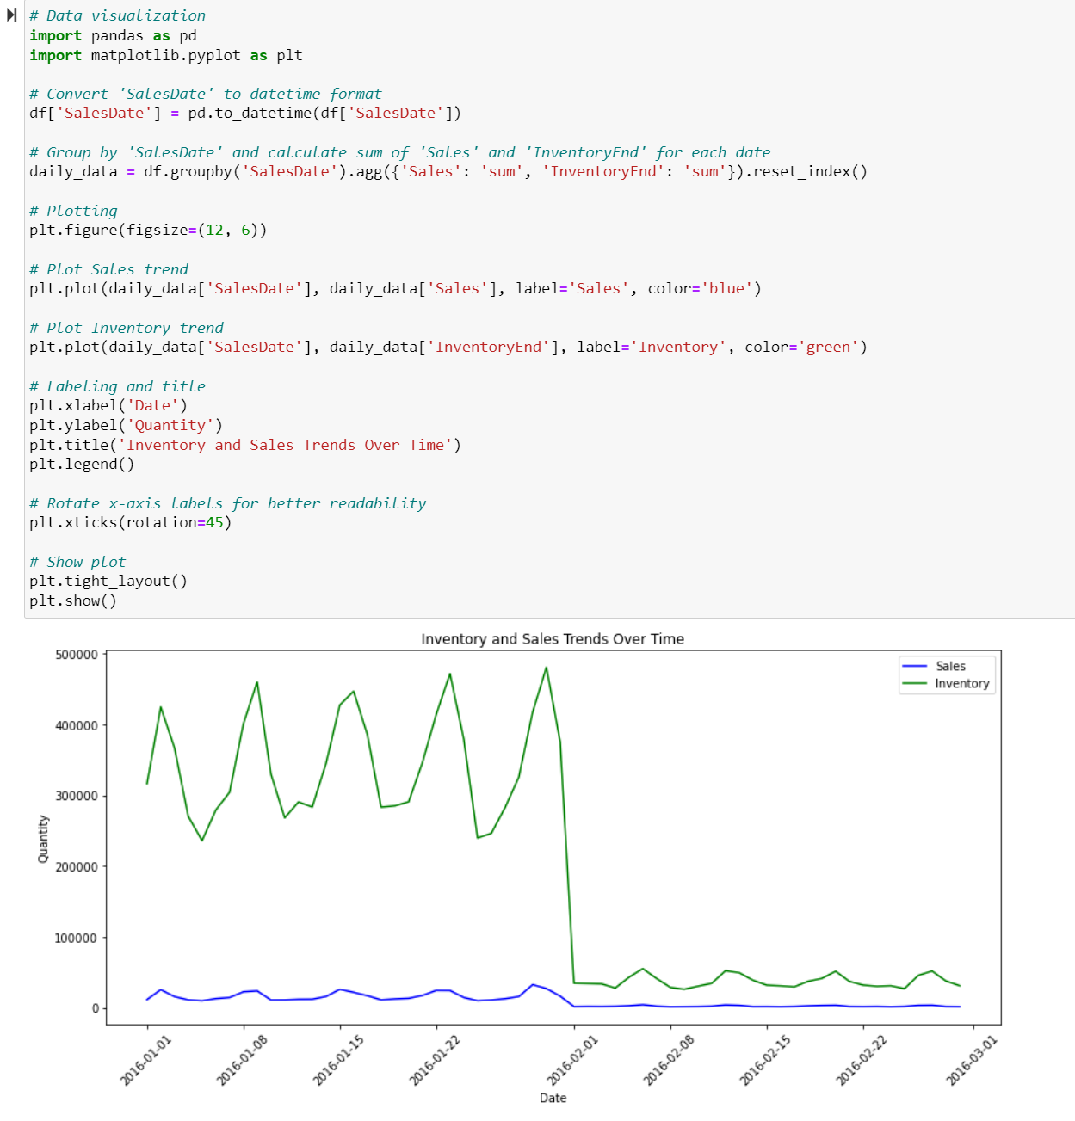
Visualizing Inventory & Sales Trends
Using Matplotlib to visualize Inventory & Sales trends over time.
Plotting sales & Inventory against dates, with labels and title for clarity.
Notes:
Random Forest Regressor is used for several reasons:
High Prediction Accuracy: Random Forest Regressor typically provides high prediction accuracy compared to other regression algorithms. It works well with both linear and non-linear relationships between features and target variables.
Robust to Overfitting: Random Forest Regressor mitigates overfitting by aggregating the predictions of multiple decision trees, each trained on a random subset of the data and features. This ensemble approach helps in generalizing well to unseen data.
Handles Large Datasets: It can handle large datasets with high dimensionality efficiently. Random Forests are parallelizable and can be trained on multiple processors simultaneously.
Feature Importance: Random Forest Regressor provides a measure of feature importance, which helps in understanding which features contribute the most to the prediction. This information is valuable for feature selection and understanding the underlying data relationships.
Robust to Outliers and Missing Values: Random Forests are robust to outliers and missing values in the data. They can handle categorical and numerical features without the need for extensive data preprocessing.
Less Prone to Bias: Unlike a single decision tree, Random Forest Regressor is less prone to bias from a single decision tree's learning process. The aggregation of multiple trees helps in reducing bias.

Slide 10
Machine Learning Model Training
Preprocessing steps including datetime conversion, feature engineering, and encoding categorical variables.
Splitting data into training and testing sets.
Training a RandomForestRegressor model and evaluating performance metrics (MAE, RMSE, R2).

Slide 11
Model Evaluation
Mean Absolute Error (MAE): The average absolute difference between the predicted and actual values is approximately 0.0046.
Root Mean Squared Error (RMSE): The square root of the mean squared error is approximately 0.0649. This indicates that, on average, the model's predictions are within 0.0649 units of the actual values.
R-squared (R2): The coefficient of determination (R-squared) is approximately 0.9999993125. This value is very close to 1, indicating that the model explains nearly all the variability in the target variable and provides an excellent fit to the data.
Notes:
The model is highly accurate and capable of predicting future inventory needs effectively.

Slide 12
Predictive Analytics and Alerts
Generating future predictions for inventory levels using the trained model.
Determining optimal range and setting thresholds for alerts.
Sending email alerts for inventory levels above or below the optimal range.

Slide 13
Conclusion
Inventory Trends: The analysis revealed trends in sales and inventory levels over time, providing insights into demand patterns and potential areas for optimization.
Machine Learning Model Performance: The machine learning model demonstrated reasonable performance in predicting future inventory levels. Evaluation metrics such as Mean Absolute Error (MAE), Root Mean Squared Error (RMSE), and R-squared (R2) indicated the model's effectiveness in capturing variations in inventory data.

Slide 14
Predictive Analytics for Inventory Management: Leveraging predictive analytics allowed for proactive inventory management by forecasting future inventory needs. This enables businesses to optimize stocking levels, minimize stockouts, and reduce excess inventory.
Alert System Implementation: The implementation of an alert system based on predictive analytics provided real-time notifications for inventory levels deviating from the optimal range. This proactive approach helps in timely decision-making and mitigating inventory-related risks.

